Slide 1



INTRODUCTION
Hello everyone! Today, our group will be discussing one of the most important issues in modern technology: the ethical challenges in Artificial Intelligence.
AI is changing the world, it powers everything from healthcare and finance to education and entertainment. But as AI becomes more powerful, it also raises ethic questions about fairness, privacy, accountability, and human values.
In this presentation, we’ll explore the major ethical concerns surrounding AI, explain real-world examples, and discuss why it’s so important to develop AI responsibly.

Slide 2


AI: Economic Impact of AI
Maijie Crystal Yang

Slide 3

AI in the Workplace
AI is changing the way we work. It helps companies save time and money, but it also means that many jobs done by people can now be done by machines.

Slide 4


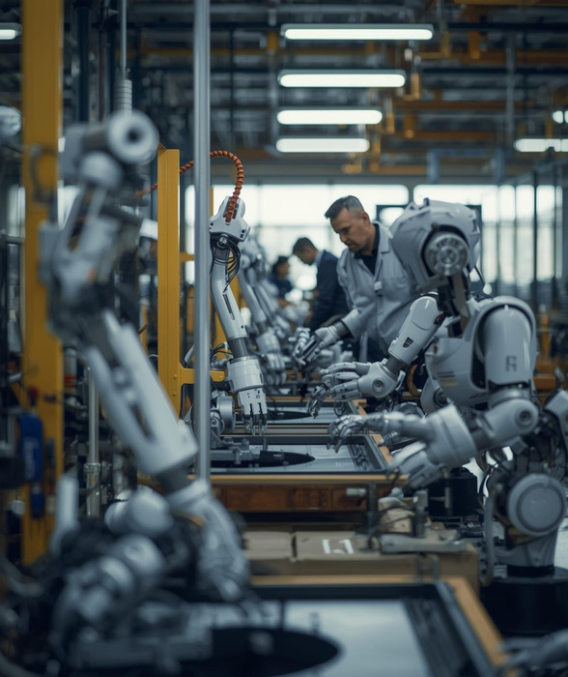



Workers in areas like factories, customer support, and delivery are starting to feel this change.
While AI brings new kinds of jobs, not everyone has the skills to catch up right away, and that’s something society really needs to think about
But job loss isn’t the only challenge. As AI grows, it also collects a lot of our personal data, which leads to another big issue:

Slide 5


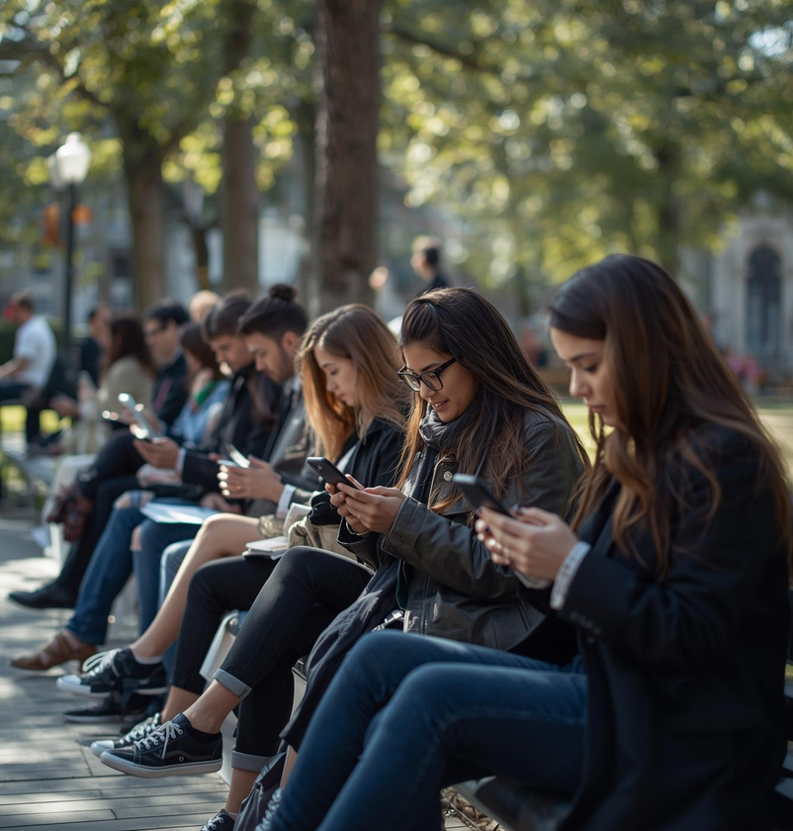
Privacy in AI

Slide 6


